Slide 1
DAY 3 - Getting Deep

Slide 2

Controller
Creating Controller
Input Validation
Controllers are composed of actions which are the most basic units that end users can address and request for execution. A controller can have one or multiple actions.
Receive Request and Response Request

Slide 3
Controller Naming
Turn the first letter into upper case.
Remove hyphens and replace any forward slashes with backward slashes.
Append the suffix Controller. Example: BookController
Prepend the controller namespace.
Huruf besar prmulaan & diikuti perkataan
Controller kat belakang mesti ada

Slide 4
Create Controller
Create file called HelloWorldController.php in folder controller. Then we will create a Hello World page
<?php
namespace app\controllers;
use yii\web\Controller;
class HelloWorldController extends Controller
{
public function actionIndex(){
return "Hello World";
}
}
Open main.php inside folder /views/layouts, insert this code
['label' => 'Contact', 'url' => ['/site/contact']],
['label' => 'HW', 'url' => ['/helloworld/index']], //this one
You can call HelloWorldController in other php field. Eg, use app\controllers\HelloWorldController

Slide 5
Create Controller + Rendering + Routing
Create file called BooksController.php in folder controller. And make a class with its function as follow
<?php
namespace app\controllers;
use Yii;
use yii\web\Controller;
use app\models\Book;
class BooksController extends Controller
{
//will be add later in rendering
}

Slide 6

Create Controller + Rendering + Routing
In BooksController, create a function as follow:
public function actionList(){
$bookModel = new Book();
return $this->render('list', [
'bookModel' => $bookModel,
]);
}
public function actionAdd(){
$bookModel = new Book();
return $this->render('add', [
'bookModel' => $bookModel,
]);
}
Locate file list.php inside folder /views/books. You can call $bookModel in list.php
Locate file add.php inside folder /views/books. You can call $bookModel in add.php
$bookModel = new Book(); calls Book model

Slide 7
Create Controller + Rendering + Routing
Open urlManager.php in /vendor/yiisoft/yii2/web. Find rules = []
Make a route
public $rules = ['books/listBook' => 'books/list',
'books/add' => 'books/add'];
public function actionList(){
$bookModel = new Book();
return $this->render('list', [
'bookModel' => $bookModel,
]);
}
BooksController
http://localhost:8080/books/listBook

Slide 8
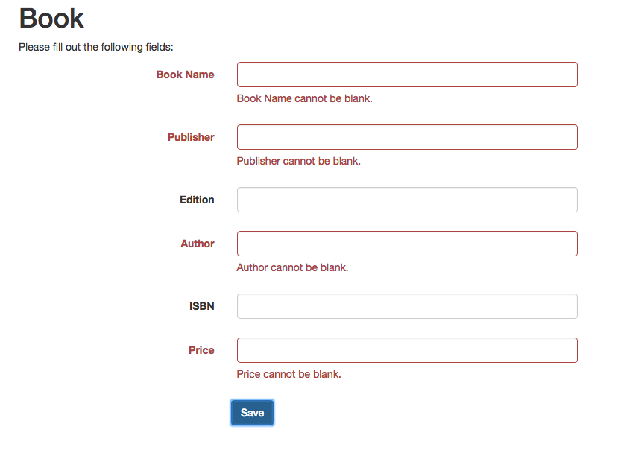
Input Validation
model->load() will load the rules in the model. Result a validation like below
public function actionAdd()
{
$bookModel = new Books();
$bookname = '';
if ($bookModel->load(Yii::$app->request->post())) {
$bookModel->storeTable(Yii::$app->request->post());
return $this->render('list', ['bookModel' => $bookModel]);
}else{
return $this->render('add', [
'bookModel' => $bookModel,
'bookname' => $bookname
]);
}
}

Slide 9
Forms
Creating form
A form consist a label and field for user to put an input and to receive the outcome.
A form to be display to the user

Slide 10
Creating Form
Create file add.php in folder book
<?php
use yii\helpers\Html;
use yii\widgets\ActiveForm;
$this->title = 'Book';
$this->params['breadcrumbs'][] = $this->title;
?>
<div class="book-add">
<h1><?= Html::encode($this->title) ?></h1>
<p>Please fill out the field below:</p>
<?php $form = ActiveForm::begin([ 'options' => ['class' => 'form-horizontal'],
'fieldConfig' => [
'template' => "{label}\n<div class=\"col-lg-3\">{input}{error}</div>",
'labelOptions' => ['class' => 'col-lg-4 control-label'],
]]); ?>
<?= $form->field($bookModel, 'bookname') ?>
<?= $form->field($bookModel, 'publisher') ?>
<?= $form->field($bookModel, 'edition') ?>
<?= $form->field($bookModel, 'author') ?>
<?= $form->field($bookModel, 'price') ?>
<?= Html::submitButton('Save') ?>
<?php ActiveForm::end(); ?>
</div>
Calling ActiveForm and HTML component
You can set method by adding ‘method’ => ‘get’ or ‘method’=> ‘post’. You can also set custom action by adding ‘action’ => ‘your url’
$bookModel has been passed on from BooksController

Slide 11
Handling Request
HTTP Request
Request Parameter
Check Method
Requests made to an application are represented in terms of yii\web\Request objects which provide information such as request parameters, HTTP headers, cookies, etc
POST, GET to get information

Slide 12
HTTP Request
Request
By sending HTTP Request (POST, GET)
user
controller

Slide 13
Request Parameter (GET)
Get → hantar cara direct tp di encrip kan code trsebut
Post → hantar cara bawah meja gitu/trsembunyi
$request = Yii::$app->request;
$get = $request->get();
// equivalent to: $get = $_GET;
$id = $request->get('id');
// equivalent to: $id = isset($_GET['id']) ? $_GET['id'] : null;
$id = $request->get('id', 1);
// equivalent to: $id = isset($_GET['id']) ? $_GET['id'] : 1;

Slide 14
Request Parameter (POST)
$request = Yii::$app->request;
$get = $request->post();
// equivalent to: $post = $_POST;
$id = $request->post('id');
// equivalent to: $id = isset($_POST['id']) ? $_POST['id'] : null;
$id = $request->post('id', 1);
// equivalent to: $id = isset($_POST['id']) ? $_POST['id'] : 1;

Slide 15
Check Method
A whole set of boolean properties that check http request and will return FALSE or TRUE
$request = Yii::$app->request;
if ($request->isAjax) { /* the request is an AJAX request */ }
if ($request->isGet) { /* the request method is GET */ }
if ($request->isPost) { /* the request method is POST */ }
if ($request->isPut) { /* the request method is PUT */ }

Slide 16
Working with DB
Data Access Object: Executing SQL Queries
Query Builder
Active Record
Fill in the Book table with some data

Slide 17
Data Access Object : Execute Queries
Data Access Object createCommand can be use in Controller or Model. However, it is most suitable in model to make coding look more organized
public function getListUseCommand(){
// return a set of rows. each row is an associative array of column names and values.
// an empty array is returned if the query returned no results
$bookAll = Yii::$app->db->createCommand('SELECT * FROM books')
->queryAll();
// return a single row (the first row)
// false is returned if the query has no result
$bookOne = Yii::$app->db->createCommand('SELECT * FROM books WHERE id=1')
->queryOne();
// return a single column (the first column)
// an empty array is returned if the query returned no results
$bookColumn = Yii::$app->db->createCommand('SELECT bookname FROM books')
->queryColumn();
// return a scalar value
// false is returned if the query has no result
$bookScalar = Yii::$app->db->createCommand('SELECT COUNT(*) FROM books')
->queryScalar();
return $bookColumn;
}
<?php foreach ($bookModel->getListUseCommand() as $book) {
echo '<tr><td>' . $book['bookname'] . '</td><td>' . $book['publisher'] . '</td><td>' . $book['edition'] . '</td><td>' . $book['author'] . '</td><td>' . $book['price'] . '</td></tr>';
} ?>
<?php $listbook = $bookModel->getListUseCommand();
echo '<tr><td>' . $listbook['bookname'] . '</td><td>' . $listbook['publisher'] . '</td><td>' . $listbook['edition'] . '</td><td>' . $listbook['author'] . '</td><td>' . $listbook['price'] . '</td></tr>';
?>
copy dlm book.php
<?php $singleBook = $bookModel->getListUseCommand();
echo '<tr><td colspan="5">' . $singleBook[0] . '</td></tr>';
?>
<?php $num = $bookModel->getListUseCommand();
echo '<tr><td colspan="5">'.$num. '</td></tr>';
?>

Slide 18
Query Builder
Built on top of Database Access Objects, query builder allows you to construct a SQL query in a programmatic and DBMS-agnostic way.
public function getTableList()
{
$book = (new Query())->select('*')->from('books')->where(‘id=1’)->all();
return $book;
}
There are more:
Select all set of a row from table books where id must be 1
groupBy()
orderBy()
join()
limit()
having()
offset()
union()

Slide 19
Active Record
Active Record provides an object-oriented interface for accessing and manipulating data stored in databases. First, extend your model class with ActiveRecord
use yii\db\ActiveRecord;
class Books extends ActiveRecord
{
Call ActiveRecord and extend the class

Slide 20
Active Record
Below are the function to store, update and delete data. These function stays in model.
public function storeTable($bookArray){
$book = new Book();
$book->bookname = $bookArray['bookname'];
$book->publisher = $bookArray['publisher'];
$book->edition = $bookArray['edition'];
$book->author = $bookArray['author'];
$book->price = $bookArray['price'];
$book->isbn = $bookArray['isbn'];
$book->save();
}
public function updateTable($id, $bookArray){
$book = Books::findOne($id);
$book->bookname = $bookArray['Books']['bookname'];
$book->publisher = $bookArray['Books']['publisher'];
$book->edition = $bookArray['Books']['edition'];
$book->author = $bookArray['Books']['author'];
$book->price = $bookArray['Books']['price'];
$book->isbn = $bookArray['Books']['isbn'];
$book->save();
}
public function deleteTable($id){
$book = Books::findOne($id);
$book->delete();
}

Slide 21
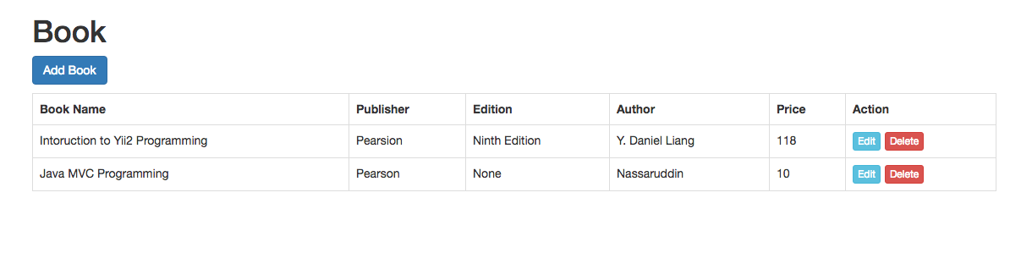
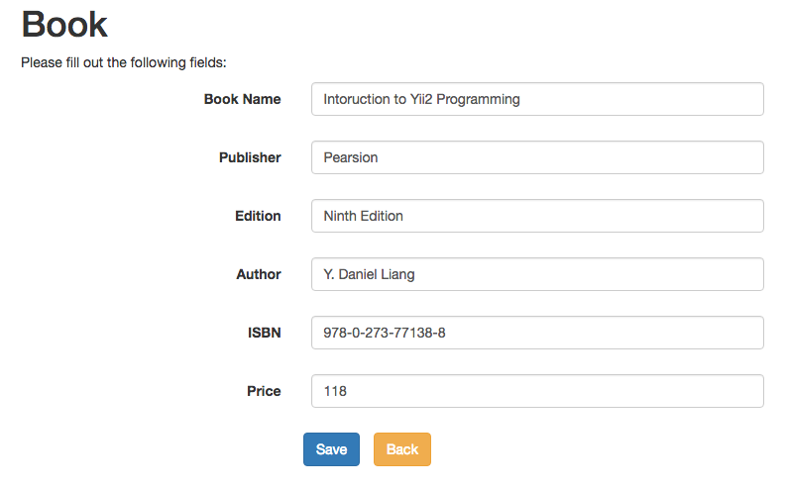
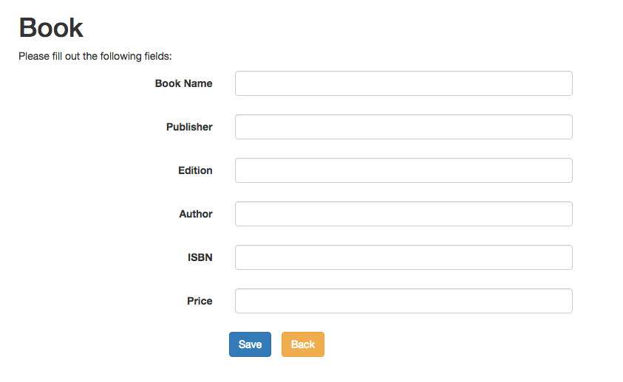
Excercise
Complete the CRUD for Book.

